Slide 1

CSC 120 PROJECT
SAN FRANCISCO AIRBNB REPORT
Thang (Alan) Bui

Slide 2
Parts 1: Analysis among three years

Slide 3
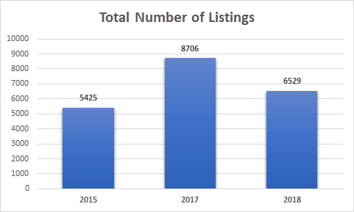
Number of listings:
Notes:
Over the course of three years, the total number of listings peaked in 2017 before declining.
However, The average number of listings per host generally increased over the years.

Slide 4
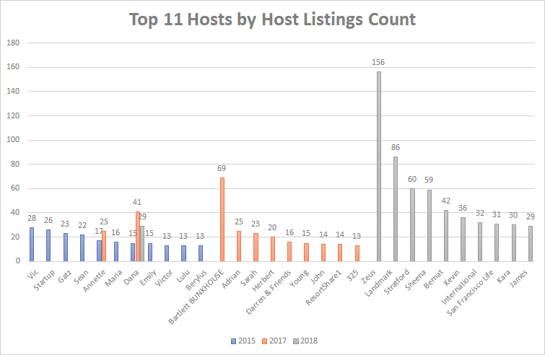
2. Top 11 hosts by host’s listings count:
Notes:
The retention rate of the top 11 over the 3 years is low: Only 2 hosts remained in the list the next year(s).
The number of listings the Top 11 hosts have tends to increase over the years.

Slide 5
Part 2: 2018 analysis

Slide 6
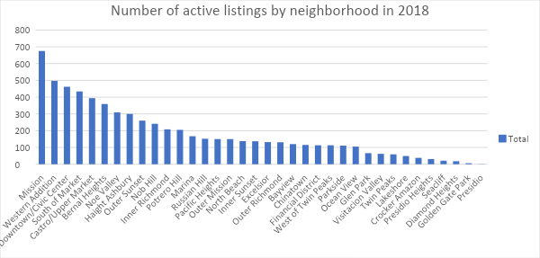
Number of active listings by neighborhood:
Notes:
Mission held the highest number of active listings in San Francisco, closely followed by Western Addition and Downtown/Civic Center.
Presidio, Golden Gate Park and Diamond Heights held the lowest numbers with only 1, 6 and 18 listings respectively.

Slide 7
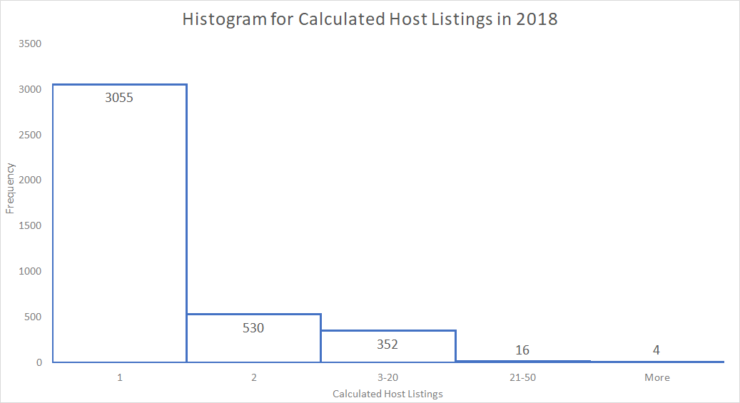
2. Calculated host listings:
Notes:
The vast majority of hosts have only 1 listing.

Slide 8
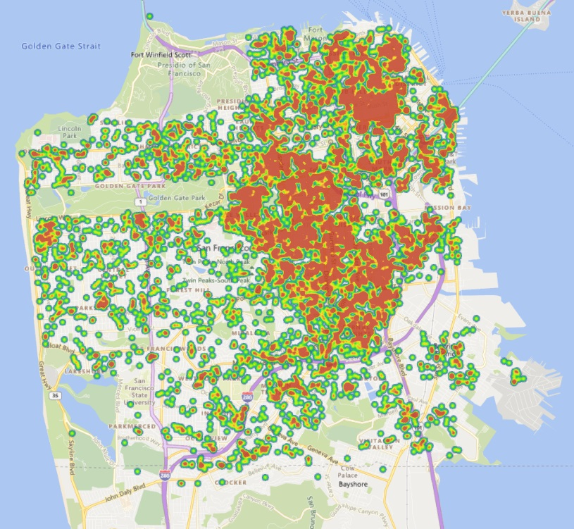
3. Geographical distribution of active listings:
Notes:
Postings are largely concentrated in the northeast quadrant of the city.

Slide 9
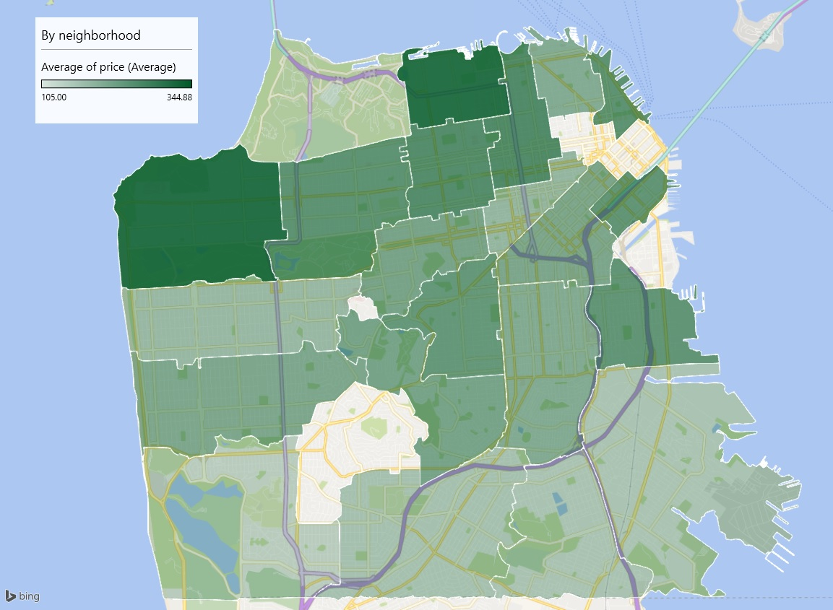
4. Average price by neighborhood:
Notes:
Prices increase as we go northward, most expensive in the north (Marina) and northwest (Seacliff)

Slide 10
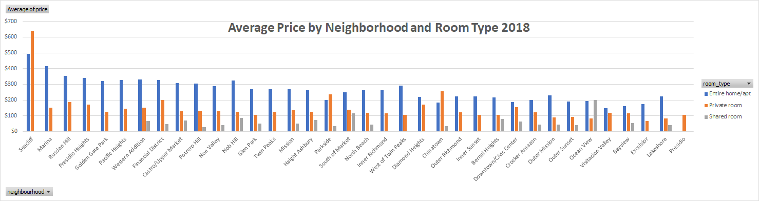
5. Average price by neighborhood and room type:
Notes:
Seacliff has listings with the highest prices, both Entire home/apt and Private room type.
Room type of Entire home/apt has the highest price in most neighborhoods, except for Seacliff, Parkside, and Chinatown.

Slide 11

Thank you!

